Slide 1
CS61C: Great Ideas in Computer Architecture (aka Machine Structures)
Lecture 8: RISC-V Part 1
Instructors: Lisa Yan, Justin Yokota

Slide 2
Computing in the News
Memory safe programming languages are on the rise. Here's how developers should respond | ZDNET

Slide 3
Agenda
Warm-Up: Floating Point
Intro to Assembly Languages
RISC-V Programming Paradigm
add and sub
Immediates: The addi instruction
Demo: Venus

Slide 4
Agenda
Warm-Up: Floating Point
Intro to Assembly Languages
RISC-V Programming Paradigm
add and sub
Immediates: The addi instruction
Demo: Venus

Slide 5
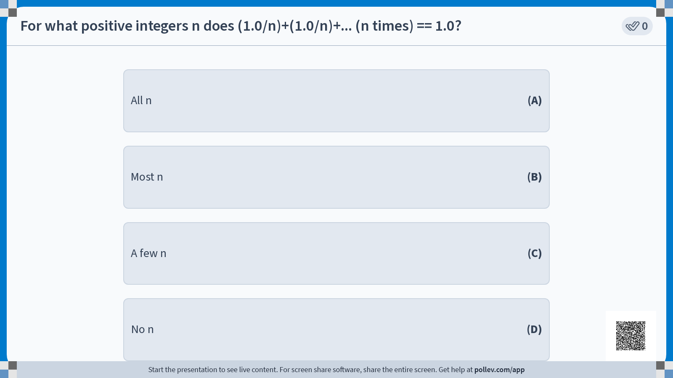

Slide 6
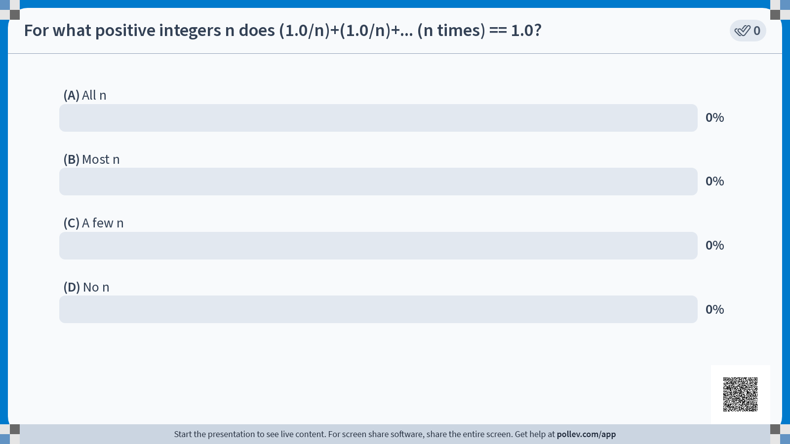

Slide 7

Notes:
Note that all the powers of 2 are exact, because powers of 2 are exactly representable by a floating point number. When working with doubles/floats, you should assume that every step of math you do has some small precision loss.

Slide 8
Agenda
Warm-Up: Floating Point Questions
Intro to Assembly Languages
RISC-V Programming Paradigm
add and sub
Immediates: The addi instruction
Demo: Venus

Slide 9
Building a computer from the ground up
Any program we write needs to run on a circuit in order to be useful.
However, circuit-level programming is highly restrictive.
With C, a human designed the programming language
With a circuit, silicon dictates what language we can design.
Early computers essentially had to be rebuilt for every program you wanted to run, since different computations required different circuits.
One major advancement in computer science was the creation of software-based languages.
Instead of making a new circuit for every problem you want to solve, make a circuit (called a CPU) that solves the problem “Carry out a sequence of instructions stored as binary data”. Then solve your problem by writing instructions in binary data.

Slide 10
Assembly Language
We don’t want to change the CPU after we build it, so when designing our CPU, we need to decide on a specific set of instructions that will be supported by the CPU, along with a way to translate each instruction to a binary form.
Different CPUs implement different sets of instructions. The set of instructions a particular CPU implements is an Instruction Set Architecture (ISA), and the programming language defined by the ISA is commonly known as an assembly language.
Examples: ARM (cell phones), Intel x86 (i9, i7, i5, i3), IBM/Motorola PowerPC (old Macs), MIPS, RISC-V, ...

Slide 11
Assembly Language
C is generally considered a “lower-level” language than Java or Python, because it’s “closer” to the underlying CPU
Less is automated by the language, so you get faster runtimes, but have to keep track of more things
Ultimately, though, C is still considered a high-level language, because there’s still a lot done for you.
C lets you write a bunch of operations in a single line of code, and splits it up for you
C sets up the stack for you and keeps track of where it stored local variables
C lets you just call a function, and you can expect that calling functions won’t affect any local variables you have.
C lets you name variables, and will keep track of that name, and even the type of variable that name refers to.
Once you start working with assembly languages, almost everything is the result of an explicit instruction by the programmer.

Slide 12
Instruction Set Architectures
Early trend in ISA design was to add more and more instructions to new CPUs to do elaborate operations
VAX architecture had an instruction to multiply polynomials!
RISC philosophy (Cocke IBM, Patterson, Hennessy, 1980s) – Reduced Instruction Set Computing
Keep the instruction set small and simple.
Let software do complicated operations by composing simpler ones.
A simpler CPU is easier to iterate on (allowing for faster development), and can generally be made faster than a complex CPU (we’re often limited by the slowest instruction we decide to implement)

Slide 13
RISC-V
For the purposes of this class, we’ll be learning RISC-V as our assembly language
Why?
RISC-V is relatively simple, in that there’s only a few instructions in the base instruction set, and that instructions themselves follow a consistent format.
x86 is a more popular language (base CPU for most laptops/desktops), but is a CISC language that Huffman encodes its instructions
Project 3: Build a complete RISC-V CPU
RISC-V is relatively popular, open-source, and growing in popularity
RISC-V was invented in Berkeley in 2010. If we teach students RISC-V, they’re more likely to use a RISC-V architecture in the future, thus allowing RISC-V to keep growing in popularity.

Slide 14
RISC-V Resources
CS 61C Reference Card
https://cs61c.org/sp24/pdfs/resources/reference-card.pdf
Lists out the entire base architecture
Venus
https://venus.cs61c.org/
Online RISC-V simulator

Slide 15
Agenda
Warm-Up: Floating Point
Intro to Assembly Languages
RISC-V Programming Paradigm
add and sub
Immediates: The addi instruction
Demo: Venus

Slide 16
Overarching view of RISC-V
A RISC-V system is composed of two main parts:
The CPU, which is responsible for computing
Main memory, which is responsible for long-term data storage (Monday)
The CPU is designed to be extremely fast, often completing one instruction every nanosecond or faster
Note: Light travels 30 cm in 1 nanosecond. In other words, it takes longer for light to travel from one end of my laptop to the other, than it does for a CPU to finish one instruction.
Going to main memory often takes hundreds or even thousands of times longer.
The CPU can store a small amount of memory, through components called registers.

Slide 17
Registers
A register is a CPU component specifically designed to store a small amount of data. Each register stores 32 bits of data (for a 32-bit system) or 64 bits of data (for a 64-bit system). For the purposes of this class, we consider RV32 only (which uses 32-bit registers)
This data is purely binary; types do not exist at the assembly level
It’s the programmer’s responsibility to keep track of that register and its type.
Registers are a hardware component, so once you make the CPU, you can’t change the number of registers available.
Can't "make" a new register when defining a new variable; have to delete an existing register for each variable you make.
RISC-V gives access to 32 integer registers

Slide 18
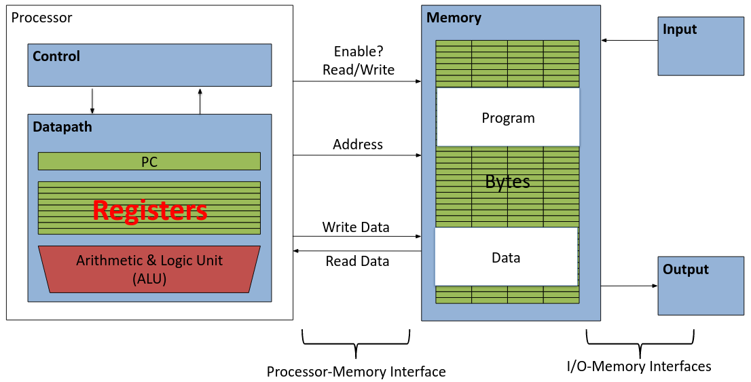
Aside: Registers are Inside the Processor

Slide 19
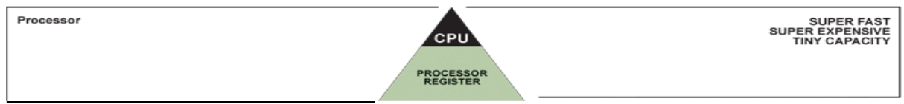
Great Idea #3: Principle of Locality / Memory Hierarchy

Slide 20
Registers
Registers are a hardware component, so once you make the CPU, you can’t change the number of registers available.
RISC-V gives access to 32 integer registers
Registers are numbered from 0 to 31
Referred to by number: x0 – x31
The register x0 is special and always stores 0 (More on this later). So only 31 registers are available to hold variables
The other 31 registers are all identical in behavior; the only difference between different registers is the conventions we follow when using them.
Later, we’ll give them names to hint at what conventions get used on which registers.

Slide 21
Instructions
Each line of RISC-V code is a single instruction, which executes a simple operation on registers.
Instructions are generally written in the format
<instruction name> <destination register> <operands>
Ex. “add x5 x6 x7” means “Add the values stored in x6 and x7, and store the result in x5”
Commas can be added between registers (“add x5, x6, x7”), but this is optional.

Slide 22
Instructions
Comments are written using the # symbol.
Anything written after a # on a line gets ignored
Similar to Python comment syntax
Important: Comments are far more important in RISC-V than in other languages. In a higher level language, you can sometimes get away with choosing variable names so that the code is self-documenting. In RISC-V, we don’t have variable names!
Uncommented RISC-V code is practically impossible to debug properly. If you don’t comment your code, we may not be able to help debug in office hours.

Slide 23
Addition and Subtraction of Integers (1/3)
Addition in Assembly
Example: add x1,x2,x3 (in RISC-V)
Equivalent to: a = b + c (in C)
where C variables ⇔ RISC-V registers are: a ⇔ x1, b ⇔ x2, c ⇔ x3
Subtraction in Assembly
Example: sub x3,x4,x5 (in RISC-V)
Equivalent to: d = e - f (in C)
where C variables ⇔ RISC-V registers are: d ⇔ x3, e ⇔ x4, f ⇔ x5

Slide 24
Addition and Subtraction of Integers (2/3)
How to do the following C statement? a = b + c + d - e;
Break into multiple instructions add x10, x1, x2 # a_temp = b + c add x10, x10, x3 # a_temp = a_temp + d sub x10, x10, x4 # a = a_temp - e
Note: A single line of C may break up into several lines of RISC-V.
Note: Everything after the hash mark on each line is ignored (comments).

Slide 25
Addition and Subtraction of Integers (3/3)
How do we do this? f = (g + h) - (i + j);
Use intermediate temporary register add x5, x20, x21 # a_temp = g + h add x6, x22, x23 # b_temp = i + j sub x19, x5, x6 # f = (g + h) - (i + j)
Note: By using x5 and x6 in this way, we overwrite any data that used to be in those registers.
Note: We could also have written this as f = g + h - i - j; which allows us to compute this without any temporary registers. A smart compiler may write code this way instead.

Slide 26
Immediates
Immediates are numerical constants.
They appear often in code, so there are special instructions for them.
Add Immediate:
addi x3,x4,10 (in RISC-V)
f = g + 10 (in C)
where RISC-V registers x3,x4 are associated with C variables f,g
Syntax similar to add instruction, except that last argument is a number instead of a register.
Common mistake: addi x3,x4,x5 / add x3,x4,10 are both invalid RISC-V instructions; be careful with using the register version vs the immediate version of an instruction!

Slide 27
Immediates
There is no Subtract Immediate in RISC-V: Why?
There are add and sub, but no addi counterpart
Limit types of operations that can be done to absolute minimum
if an operation can be decomposed into a simpler operation, don’t include it
addi …, -X = subi …, X => so no subi addi x3,x4,-10 (in RISC-V) f = g - 10 (in C)
where RISC-V registers x3,x4 are associated with C variables f,g

Slide 28
Register Zero
One particular immediate, the number zero (0), appears very often in code.
So the register zero (x0) is ‘hard-wired’ to value 0; e.g. add x3,x4,x0 (in RISC-V) f=g (in C)
where RISC-V registers x3,x4 are associated with C variables f, g
Defined in hardware, so an instruction add x0,x3,x4 will not do anything!

Slide 29
Agenda
Warm-Up: Floating Point
Intro to Assembly Languages
RISC-V Programming Paradigm
add and sub
Immediates: The addi instruction
Demo: Venus

Slide 30
Venus Demo
Done in lecture
Add 1+2+3+4+5
addi x5 x0 0 addi x6 x0 5 add x5 x5 x6 addi x6 x6 -1 add x5 x5 x6 addi x6 x6 -1 add x5 x5 x6 addi x6 x6 -1 add x5 x5 x6 addi x6 x6 -1 add x5 x5 x6 addi x6 x6 -1

